Slide 1

BEGINNER TO EXPERT GUARANTEED
ULTIMATE IT COURSE
ACCESS COURSE PLAYLIST LINK IN DESCRIPTION
SUBSCRIBE!!!

Slide 2
Skill Agenda :-
Hardware Skill (10 Videos)
Networking Skill (25 Videos)
Linux Skill (10 Videos)
CMD & Powershell (20 Videos)
Operating System (25 Videos)
Windows Server (10 Videos)
MS Office & Outlook (5 Videos)
ITIL (10 Videos)
Cyber Security (20 Videos)

Slide 3
Have a look!

Slide 4
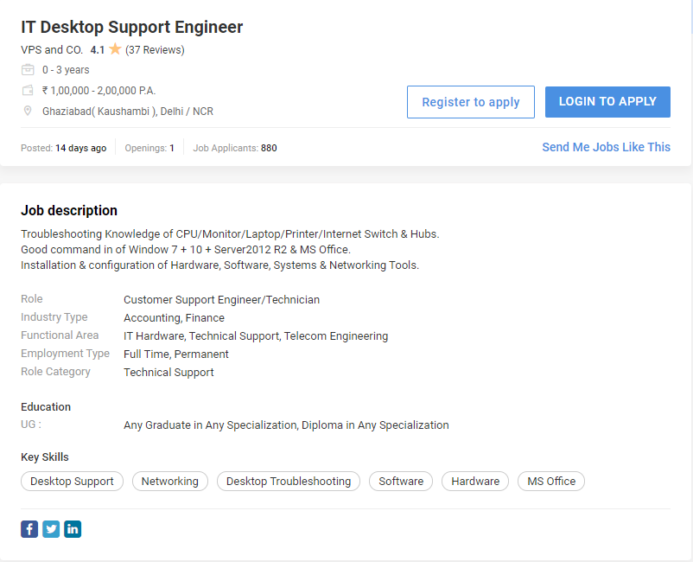

Slide 5
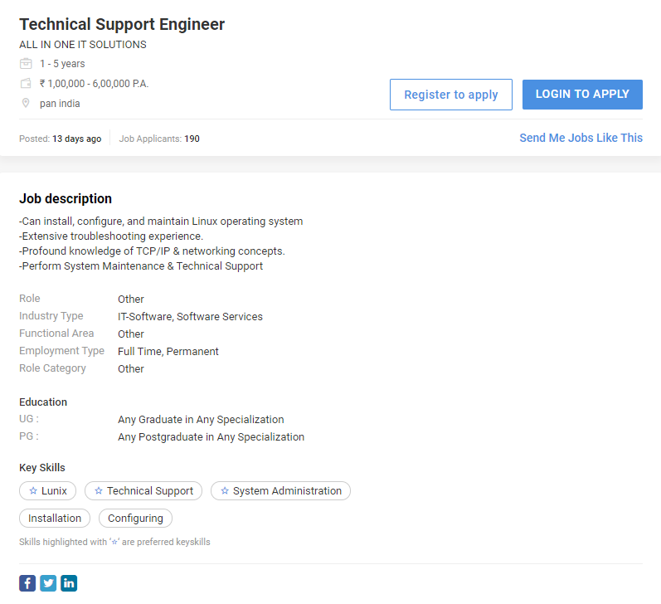

Slide 6
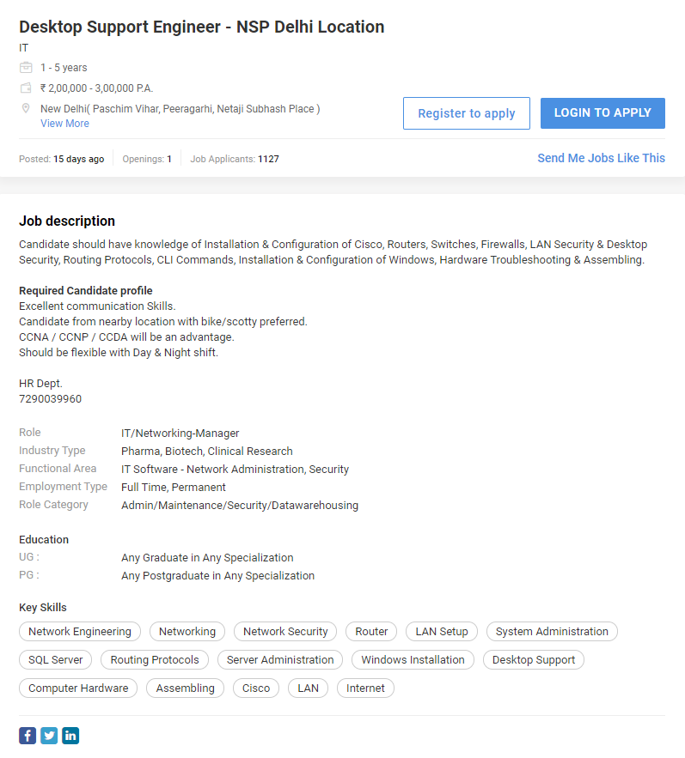

Slide 7
More 4 U!

